Slide 1
Relations and Their Properties
IT-209: Discrete Mathematics

Slide 2
Binary Relations
Let A and B be sets. A binary relation from A to B is a subset of A × B.
A binary relation from A to B is a set R of ordered pairs where the first element of each ordered pair comes from A and the second element comes from B.
If (a,b) ∈ R, then we say a is related to b by R. This is sometimes written as a R b.

Slide 3
Binary Relations - Example
Let A = {0, 1, 2} and B = {a, b}. Then relation R from A to B is defined as:
  R = {(0, a), (0, b), (1, a), (2, b)}
  Relations can be represented graphically
    Arrow representation
    Table representation
0
a
R | a | b
0 | × | ×
1 | ×
2 |  | ×
1
b
2

Slide 4
Relations on a set
A relation on the set A is a relation from A to A.
A relation on a set is a subset of A × A
  Example: Consider the following relations on set of integers:
    R₁ = {(a, b) | a ≤ b}
    R₂ = {(a, b) | a > b}
    R₃ = {(a, b) | a = b or a = ̶ b}
    R₄ = {(a, b) | a = b}
    R₅ = {(a, b) | a = b + 1}
    R₆ = {(a, b) | a + b ≤ 3}
  Which of these relation contain each pairs (1, 1), (1, 2), (2, 1), (1, -1), and (2, 2)?
  Answer:
    (1, 1) is in R₁, R₃, R₄, and R₆
    (1, 2) is in R₁, and R₆
    (2, 1) is in R₂, R₅, and R₆
    (1, -1) is in R₂, R₃, and R₆
    (2, 2) is in R₁, R₃, and R₄

Slide 5
Properties on Relations
There are several properties that are used to classify relations on a set.
  Reflexive
  Symmetric
  Antisymmetric
  Transitive

Slide 6
Reflexive
A relation R on a set A is called reflexive if (a,a) ∈ R for every element a ∈ A.
∀a ((a, a) ∈ R), where the u. of d. is the set of all elements in the set.
A relation R on a set A is reflexive if every element of A is related to itself.
  Example: Is the “divides” relation i.e. R = {(a, b) | a divides b} on the set of integers is reflexive?
  Answer: Yes, because a |a is true for all positive integers. So the “divides” relation is reflexive.

Slide 7
Symmetric
A relation R on a set A is called symmetric if (b, a) ∈ R whenever (a, b) ∈ R, for some a, b ∈ A.
A relation R on a set A such that (a, b) ∈ R and (b, a) ∈ R only if a = b for a, b ∈ A is called antisymmetric.
  Note that antisymmetric is not the opposite of symmetric. A relation can be both.
A relation R on a set A is called asymmetric if (a, b) ∈ R → (b, a) ∉ R.
  Example: Is the “divides” relation i.e. R = {(a, b) | a divides b} on the set of integers is symmetric? Is it antisemmetric?
  Answer: The relation is not symmetric because (1, 2) ∈ R but (2, 1) ∉ R.
  The relation is antisymmetric, if a and b are positive integer s with a | b and b | a, then a = b.

Slide 8
Transitive
A relation R on a set A, is called transitive if whenever (a, b) ∈ R and (b, c) ∈ R, then (a, c) ∈ R , for (a, b, c) ∈ A.
  Example: Is the “divides” relation i.e. R = {(a, b) | a divides b} on the set of integers is transitive?
  Answer: Suppose a divides b and b divides c. Then there are positive integers k and l such that b = ak and c = bl. Hence c = akl = a (kl), so a divides c. It follows that the relation is transitive.
  Suppose 3 | 6 and 6 | 12 then 3 | 12.

Slide 9
List of Examples
If R is a relation on Z where (x, y) ∈ R when x ≠ y.
Is R reflexive?
No, x = x is not included.
Is R symmetric?
Yes, if x ≠ y, then y ≠ x.
Is R antisymmetric?
No, x ≠ y and y ≠ x does not imply x = y.
Is R transitive?
No, (1,2) ∈ R and (2,1) ∈ R but (1,1) ∉ R.

Slide 10
List of Examples
If R is a relation on Z where (x, y) ∈ R when xy ≥ 1
Is R reflexive?
No, 0*0 ≥ 1 is not true.
Is R symmetric?
Yes, if xy ≥ 1, then yx ≥ 1. (1*2 ≥ 1; 2*1 ≥ 1)
Is R antisymmetric?
No, 1*2 ≥ 1 and 2*1 ≥ 1, but 1 ≠ 2.
Is R transitive?
Yes, xy ≥ 1 and yz ≥ 1 implies xz ≥ 1 (1*2 ≥ 1; 2*3 ≥ 1; 1*3 ≥ 1)
(x, y and z can’t be zero and must be all positive or all negative.)

Slide 11
List of Examples
If R is a relation on Z where (x, y) ∈R when x = y + 1 or x = y - 1
Is R reflexive?
No, (2,2) ∉ R. 2 ≠ 2+1 and 2 ≠ 2-1.
Is R symmetric?
Yes, if (x, y) ∈ R, x = y + 1 → y = x - 1 or
x = y - 1 → y = x + 1. So (y, x) ∈ R. (3 = 2 + 1; 2 = 3 - 1)
Is R antisymmetric?
No, (2,1) ∈ R and (1,2) ∈ R, but 1 ≠ 2.
Is R transitive?
No, (1,2) and (2,3) ∈ R , but (1,3) ∉ R.
1 ≠ 3 + 1 and 1 ≠ 3 - 1.

Slide 12
List of Examples
If R is a relation on Z where (x, y) ∈ R when x is a multiple of y.
Is R reflexive?
Yes, (x, x) ∈ R for all x, because x is a multiple of itself.
Is R symmetric?
No, (4,2) ∈ R, but (2,4) ∉ R.
Is R antisymmetric?
No, (2,-2) ∈ R and (-2,2) ∈ R, but 2 ≠ -2.
Is R transitive?
Yes, if (x, y) ∈ R and (y, z) ∈ R, x = k*y and y = j*z j,k ∈ Z.
x = kj*z and kj ∈ Z, thus x is a multiple of z and (x, z) ∈ R.

Slide 13
List of Examples
If R is a relation on Z where (x, y) ∈ R when x and y are both negative or both nonnegative
Is R reflexive?
Yes, x has the same sign as itself so (x, x) ∈ R for all x.
Is R symmetric?
Yes, if (x, y) ∈ R then x and y are both negative or both nonnegative. It follows that y and x are as well.
Is R antisymmetric?
No, (99,132) ∈ R and (132,99) ∈ R, but 99 ≠ 132.
Is R transitive?
Yes, if (x, y) ∈ R and (y, z) ∈ R, then x, y and z are all negative or all nonnegative. Thus (x, z) ∈ R. ((-2, -3), (-3, -4), (-2, -4) ∈ R)

Slide 14
List of Examples
If R is a relation on Z where (x, y) ∈ R when x = y²
Is R reflexive?
No, (2,2) ∉ R. 2 ≠ 2².
Is R symmetric?
No, (4,2) ∈ R, but (2,4) ∉ R.
Is R antisymmetric?
Yes, if (x, y) ∈ R and (y, x) ∈ R then x = y² and y = x². The only time this holds true is when x = y (and more specifically when x = y = 1 or 0).
Is R transitive?
No, (16,4) ∈ R and (4,2) ∈ R, but (16,2) ∉ R.

Slide 15
List of Examples
If R is a relation on Z where (x, y) ∈ R when x ≥ y²
Is R reflexive?
No, (2,2) ∉ R. 2 < 2².
Is R symmetric?
No, (10,3) ∈ R, but (3,10) ∉ R.
Is R antisymmetric?
Yes, (x, y) ∈ R and (y, x) ∈ R implies that x ≥ y² and y ≥ x². The only time this holds true is when x = y (=1 or 0).
Is R transitive?
Yes, if (x, y) ∈ R and (y, z) ∈ R, then x ≥ y² and y ≥ z².
x ≥ y² ≥ (z²)² (≥ z²). Thus (x, z) ∈ R.

Slide 16
Combining Relations
Example: Let A = {1, 2, 3} and B = {1, 2, 3, 4}. The relation R₁ = {(1, 1), (2, 2), (3, 3)} and R₂ = {(1, 1), (1, 2), (1, 3), (1, 4)} can be combine to obtain
  R₁ ∪ R₂ = {(1, 1), (1, 2), (1, 3), (1, 4), (2, 2), (3, 3)}
  R₁ ∩ R₂ = {(1, 1)}
  R₁ − R₂ = {(2, 2), (3, 3)}
  R₂ − R₁ = {(1, 2), (1, 3), (1, 4)}
  R₁ ⊕ R₂ = R₁ ∪ R₂ − R₁ ∩ R₂ = {(1, 2), (1, 3), (1, 4), (2, 2), (3, 3)}

Slide 17
Combining Relations the composite of R and S
Let R be a relation from a set A to a set B and S a relation from set B to a set C. The composite of R and S is the relation consisting of ordered pairs (a,c) where a ∈ A, c ∈ C, and for which there exists an element b ∈ B such that (a, b) ∈ R and (b, c) ∈ S.
The composite of R and S is written S º R.
  Example: What is the composite of the relations R and S, where R is the relation from {1, 2, 3} to {1, 2, 3, 4} and S is a relation from {1, 2, 3, 4} to {0, 1, 2} with R = {(1, 1), (1, 4), (2, 3), (3, 1), (3, 4)} and S = {(1, 0), (2, 0), (3, 1), (3, 2), (4, 1)}?
  Answer: S º R is constructed using all ordered pair in R and S, where the second element of the ordered pair in R agrees with the first element of the ordered pair in S.
  S º R = {(1, 0), (1, 1), (2, 1), (2, 2), (3, 0), (3, 1)}

Slide 18
The powers of R, R^{n}
Let R be a relation on the set A. The powers R^{n}, n = 1, 2, 3, …, are defined inductively by
R¹ = R and R^{n+1} = R^{n} ° R
Thus the definition shows that:
  R² = R ° R
  R³ = R² ° R = (R ° R) ° R and so on.

Slide 19
Theorem 1
Prove: The relation R on a set A is transitive if and only if R^{n} ⊆ R for n = 1,2,3 . . .
Proof: We must prove this in two parts:
1) (R is transitive) → (R^{n} ⊆ R for n = 1,2,3 . . . )
2) (R^{n} ⊆ R for n = 1,2,3 . . . )→ (R is transitive).

Slide 20
The Proof – Part 1
Assume R is transitive. We must show that this implies that R^{n} ⊆ R for n = 1,2,3 . . . .
To do this, we’ll use induction.
Basis Step: R¹ ⊆ R is trivially true (R¹ = R).

Slide 21
The Proof – Part 1 (continued)
Inductive Step: Assume that R^{n} ⊆ R.
We must show that this implies that R^{n+1} ⊆ R.
Assume (a, b) ∈ R^{n+1}.
Then since R^{n+1} = R^{n} ° R, there is an element x in A such that (a, x) ∈ R and (x, b) ∈ R^{n}.
By the inductive hypothesis, i. e. R^{n} ⊆ R; (x, b) ∈ R.
Since R is transitive and (a, x) ∈ R and (x, b) ∈ R, (a, b) ∈ R. Thus R^{n+1} ⊆ R.

Slide 22
The Proof – Part 2
Now we must show that
R^{n} ⊆ R for n = 1, 2, 3 . . . → R is transitive.
Proof: Assume R^{n} ⊆ R for n = 1, 2, 3 . . . .
In particular, R² ⊆ R.
This means that if (a, b) ∈ R and (b, c) ∈ R, then by the definition of composition, (a, c) ∈ R². Since R² ⊆ R, (a, c) ∈ R.
Hence R is transitive.

Slide 23
Thank You
Study all the solved problem from your text book.
Try to solve related problems from exercise.
Text from Rosen 8.1

Slide 25
Representing Relation(7.3)
IT-209: Discrete Mathematics

Slide 26
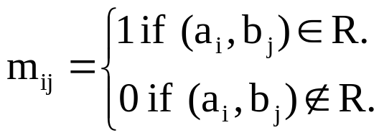
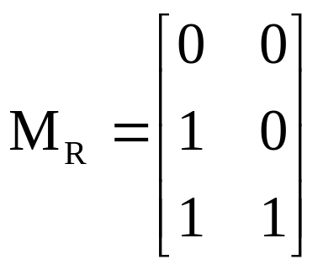
Matrix Representation of Relations
A relation between sets can be presented using zero-one matrix.
Suppose A relation R from set A = {a₁, a₂, ….., a_{m}} to B = {b₁, b₂, ….., b_{n}} can be represented as matrix M_{R} = [m_{ij}], where
  Example: A relation R between set A = {1, 2, 3} and B={1, 2}. Let R contains (a, b) if a ∈ A, b ∈ B and a > b. What would be the matrix representation of R if a₁ = 1, a₂ = 2, a₃ = 3 and b₁ = 1, b₂ = 2?
  Solution: R = {(2, 1), (3, 1), (3, 2)}. The matrix for R is:

Slide 27
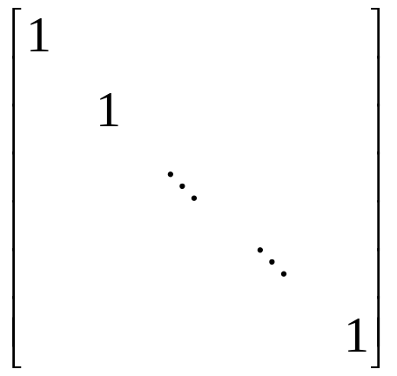
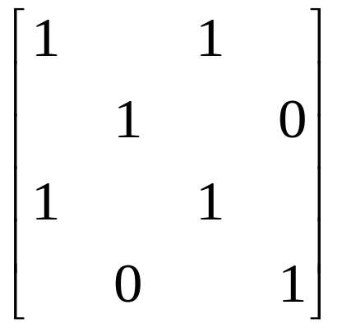
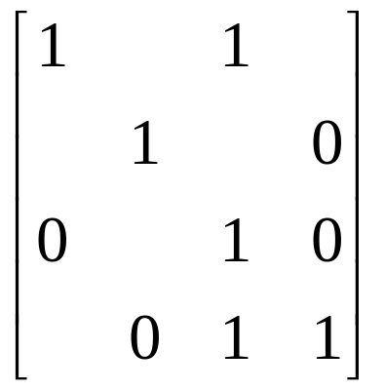
Matrix Representation of Properties of Relations
Symmetric
Antisymmetric
Reflexive

Slide 28
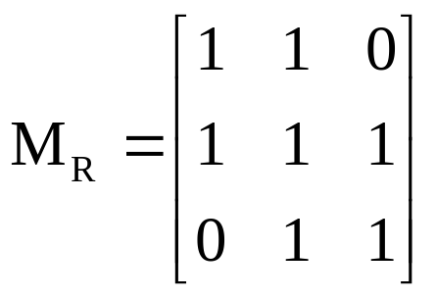
Example on Properties
Suppose that the relation R on a set is represented by the matrix M_{R} , Is R reflexive, symmetric and/or antisymmetric?
Solution:
  As the diagonal elements of the matrix is 1, so R is reflexive.
  It is also symmetric as the opposite positions are 1, so R is symmetric.
  So we can say that R is not antisymmetric.

Slide 29
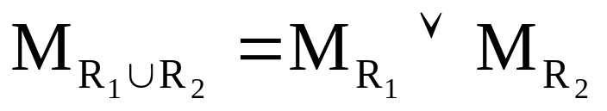

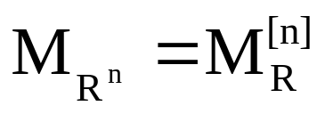
Combining Relations into Matrix form
M_{S ○ R} = M_{R} ʘ M_{S}

Slide 30
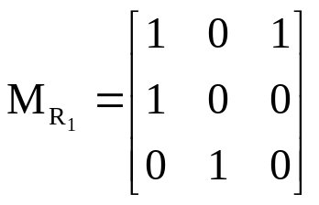
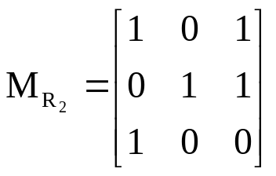
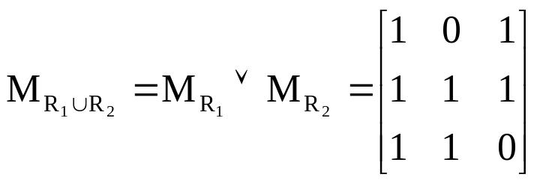
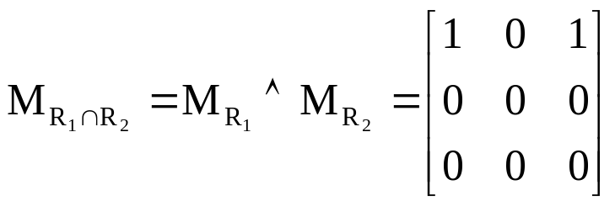
Examples
Suppose R₁ and R₂ on set A are represented by the matrices given below. Find R₁ ∪ R₂ and R₁ ∩ R₂.

Slide 31
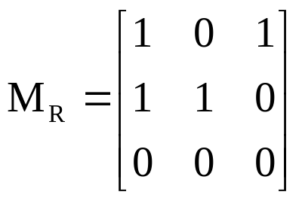
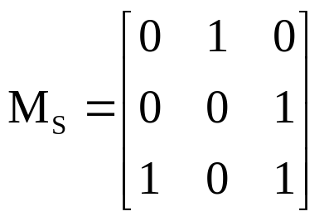
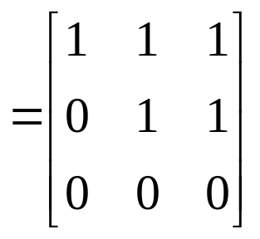
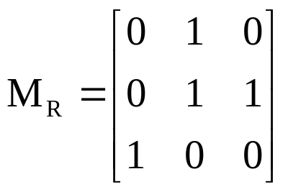
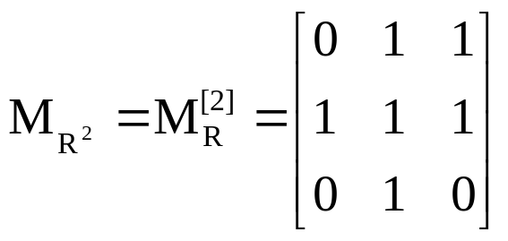
Examples
Find the matrix representing the relation S ○ R, where S and R is given as:
M_{S ○ R} = M_{R} ʘ M_{S}
Find the matrix representing the relation R², where R is given as:

Slide 32
Representing Relation Using Diagraphs
A directed graph or diagraph consists of set V of vertices (nodes) together with a set E of edges (arcs). The vertex a is called the initial vertex and b is called the terminal vertex of edge (a, b).
A edge from vertex a to a is called a loop, represented in form (a, a).
  Example: The directed graph of the relation R on set {1, 2, 3, 4} shown as: where, R = {(1, 1), (1, 3), (2, 1), (2, 3), (2, 4), (3, 1), (3, 2), (4, 1)}
1
2
4
3

Slide 33
Thank You
Study all the solved problem from your text book.
Try to solve related problems from exercise.
Text from Rosen 8.3

Slide 35
Equivalence Relations(7.5)
IT-209: Discrete Mathematics

Slide 36
Definition of Equivalence Relations
A relation R on a set A is an equivalence relation iff R is
  Reflexive
  Symmetric
  Transitive
Two elements related by an equivalence relation are called equivalent.
The notation a ~ b is often used to denote that a and b are equivalent elements w. r. t. a particular equivalence relation.
Example: Consider relation R = { (a,b) | len(a) = len(b) }, where len(a) means the length of string a
  It is reflexive: len(a) = len(a)
  It is symmetric: if len(a) = len(b), then len(b) = len(a)
  It is transitive: if len(a) = len(b) and len(b) = len(c), then len(a) = len(c)
  Thus, R is a equivalence relation

Slide 37
Equivalence relation example
Consider the relation R = { (a,b) | a ≡ b (mod m) }
  Remember that this means that m | a - b
  Called “congruence modulo m”
Is it reflexive: (a, a) ∈ R means that m | a - a
  a - a = 0, which is divisible by m
Is it symmetric: if (a,b) ∈ R then (b,a) ∈ R
  (a,b) means that m | a - b
  Or that km = a - b. Negating that, we get b - a = -km
  Thus, m | b - a, so (b,a) ∈ R
Is it transitive: if (a,b) ∈ R and (b,c) ∈ R then (a,c) ∈ R
  (a,b) means that m | a-b, or that km = a - b
  (b,c) means that m | b-c, or that lm = b - c
  (a,c) means that m | a-c, or that nm = a - c
  Adding these two, we get km+lm = (a - b) + (b - c)
  Or (k+l)m = a-c
  Thus, m divides a - c, where n = k+l
Thus, congruence modulo m is an equivalence relation

Slide 38
Equivalence Class
Let R be an equivalence relation on A. If a∈A, we define the set [a]={b∈A : bRa}, called the equivalence class containing a.
That is [a] is the set of all elements of A that are related to a.
We also define the set [A]_{R}={[a] : a∈A}, the set of all equivalence classes of A under equivalence relation R.
The element in the bracket is called a representative of the equivalence class. We could have chosen any one.
The number of equivalence classes is called the rank of the equivalence relation.

Slide 39
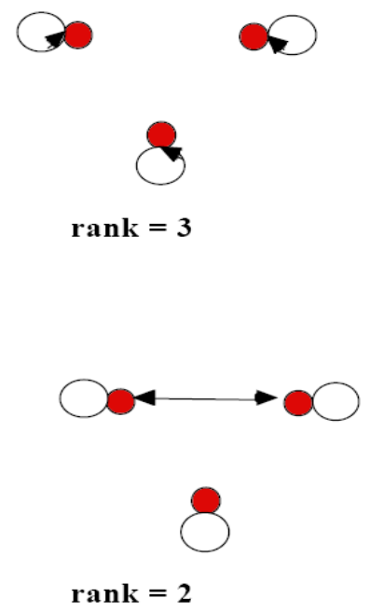
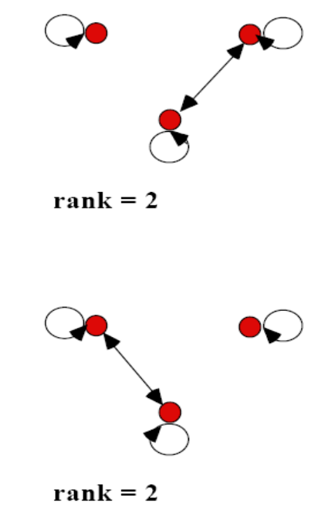
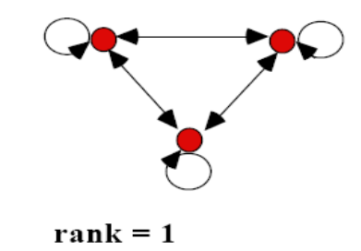
More on Equivalence Relations
It is easy to recognize equivalence relations using digraphs.
The equivalence class of a particular element forms a universal relation (contains all possible edges) between the elements in the equivalence class.
Example: All possible equivalence relations on a set A with 3 elements:

Slide 40
Theorem on Equivalence Relation
Theorem: Let R be an equivalence relation on A. Then either i) a R b or ii) [a] = [b] or iii) [a] ∩[b] ≠ Ø
Proof: We first show that i) → ii). Assume that a R b. We will prove that [a] = [b] by showing [a] ⊆ [b] and [b] ⊆ [a].
  Suppose c ∈ [a]. Then a R c. Because R is symmetric, a R b implies that there is b R a.
  Furthermore, because R is transitive and b R a and a R c, it follows that b R c. Hence c ∈ [b]. Which prove that [a] ⊆ [b]. Similarly we can prove [b] ⊆ [a].
Second, we show ii) → iii). Assume that [a] = [b]. It follows that [a]∩[b] ≠ Ø because [a] is non-empty (a ∈ [a] because R is reflexive)
Next we will show that iii) → i).
  Suppose that [a]∩[b] ≠ Ø. Then there is an element c with c ∈ [a] and c ∈ [b]. In other words, a R c and b R c. By the symmetric property c R b. Then by transitivity, because a R c and c R b, then a R b.
Because i) → ii); ii) → iii) and iii) → i), these three statements are equivalent.

Slide 41
Example equivalence classes
Consider the relation R = { (a,b) | a mod 2 = b mod 2 } on the set of integers
  Thus, all the even numbers are related to each other
  As are the odd numbers
The even numbers form an equivalence class
  As do the odd numbers
The equivalence class for the even numbers is denoted by [2] (or [4], or [784], etc.)
  [2] = { …, -4, -2, 0, 2, 4, … }
  2 is a representative of its equivalence class
There are only 2 equivalence classes formed by this equivalence relation

Slide 42
Example on equivalence classes
Consider the relation
R = { (a,b) | a = b or a = -b }
  Thus, every number is related to additive inverse
The equivalence class for an integer a:
  [7] = { 7, -7 }
  [0] = { 0 }
  [a] = { a, -a }
There are an infinite number of equivalence classes formed by this equivalence relation

Slide 43
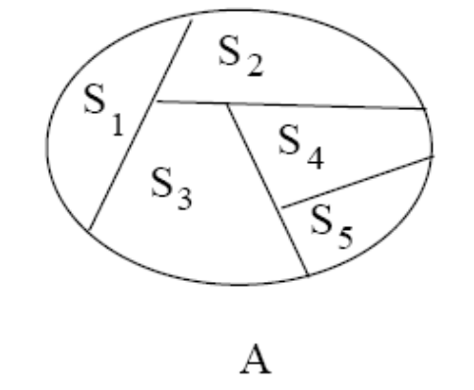
Partition of a Set
Definition: Let S₁, S₂, . . ., S_{n} be a collection of subsets of a set A. Then the collection forms a partition of A if the subsets are nonempty, disjoint and exhaust A:
  S_{i} ≠ Ø
  S_{i} ∩ S_{j} = Ø if i ≠ j
  U S_{i} = A
Note that { {}, {1,3}, {2} } is not a partition (it contains the empty set).
{ {1,2}, {2, 3} } is not a partition because the subsets are not disjoint.
{ {1}, {2} } is not a partition of {1, 2, 3} because none of its blocks contains 3.

Slide 44
Rosen, section 8.5, question 1
Which of these relations on {0, 1, 2, 3} are equivalence relations? Determine the properties of an equivalence relation that the others lack
{ (0,0), (1,1), (2,2), (3,3) }
  Has all the properties, thus, is an equivalence relation
{ (0,0), (0,2), (2,0), (2,2), (2,3), (3,2), (3,3) }
  Not reflexive: (1,1) is missing
  Not transitive: (0,2) and (2,3) are in the relation, but not (0,3)
{ (0,0), (1,1), (1,2), (2,1), (2,2), (3,3) }
  Has all the properties, thus, is an equivalence relation
{ (0,0), (1,1), (1,3), (2,2), (2,3), (3,1), (3,2) (3,3) }
  Not transitive: (1,3) and (3,2) are in the relation, but not (1,2)
{ (0,0), (0,1) (0,2), (1,0), (1,1), (1,2), (2,0), (2,2), (3,3) }
  Not symmetric: (1,2) is present, but not (2,1)
  Not transitive: (2,0) and (0,1) are in the relation, but not (2,1)

Slide 45
Rosen, Section 8.5, question 9
Suppose that A is a non-empty set, and f is a function that has A as its domain. Let R be the relation on A consisting of all ordered pairs (x,y) where f(x) = f(y)
  Meaning that x and y are related if and only if f(x) = f(y)
Show that R is an equivalence relation on A
Reflexivity: f(x) = f(x)
  True, as given the same input, a function always produces the same output
Symmetry: if f(x) = f(y) then f(y) = f(x)
  True, by the definition of equality
Transitivity: if f(x) = f(y) and f(y) = f(z) then f(x) = f(z)
  True, by the definition of equality

Slide 46
Rosen, section 8.5, question 44
Which of the following are partitions of the set of integers?
The set of even integers and the set of odd integers
  Yes, it’s a valid partition
The set of positive integers and the set of negative integers
  No: 0 is in neither set
The set of integers divisible by 3, the set of integers leaving a remainder of 1 when divided by 3, and the set of integers leaving a remaineder of 2 when divided by 3
  Yes, it’s a valid partition
The set of integers less than -100, the set of integers with absolute value not exceeding 100, and the set of integers greater than 100
  Yes, it’s a valid partition
The set of integers not divisible by 3, the set of even integers, and the set of integers that leave a remainder of 3 when divided by 6
  The first two sets are not disjoint (2 is in both), so it’s not a valid partition

Slide 47
Thank You
Study all the solved problem from your text book.
Try to solve related problems from exercise.
Text from Rosen 8.5

